Slide 1
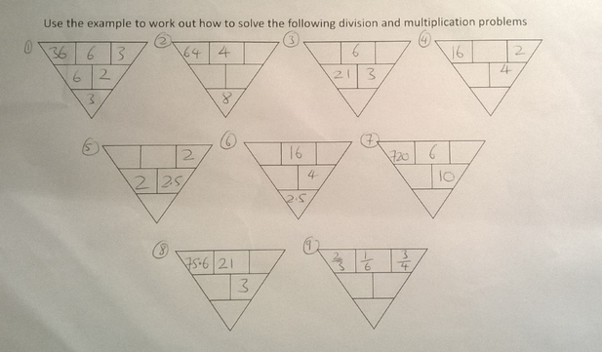

Slide 2
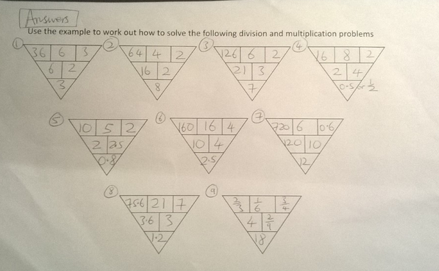

Slide 3
Use the example to work out how to solve the following division and multiplication problems

