Slide 1
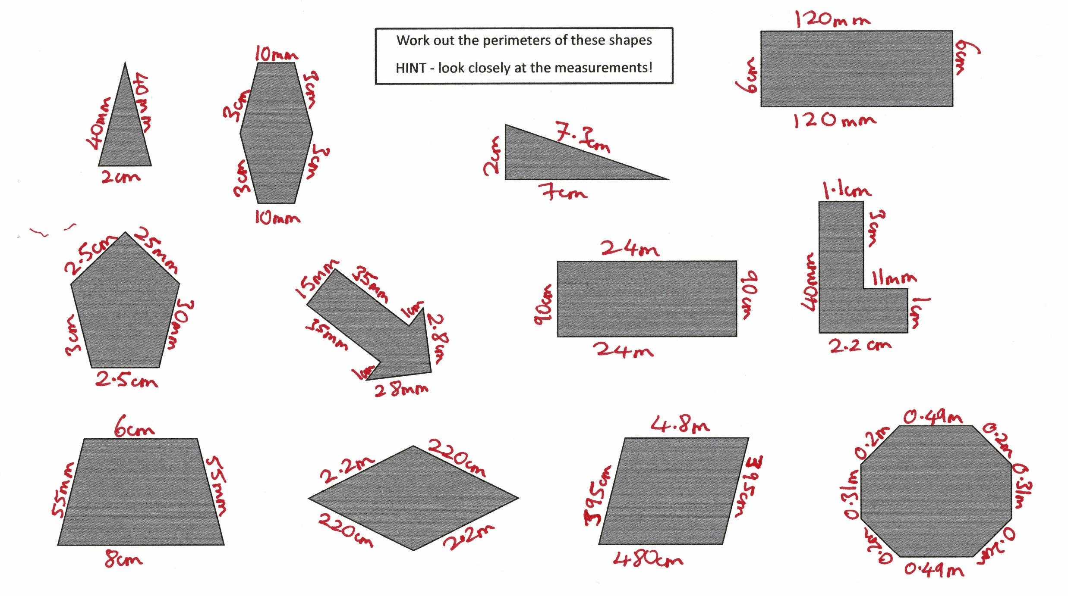

Slide 2
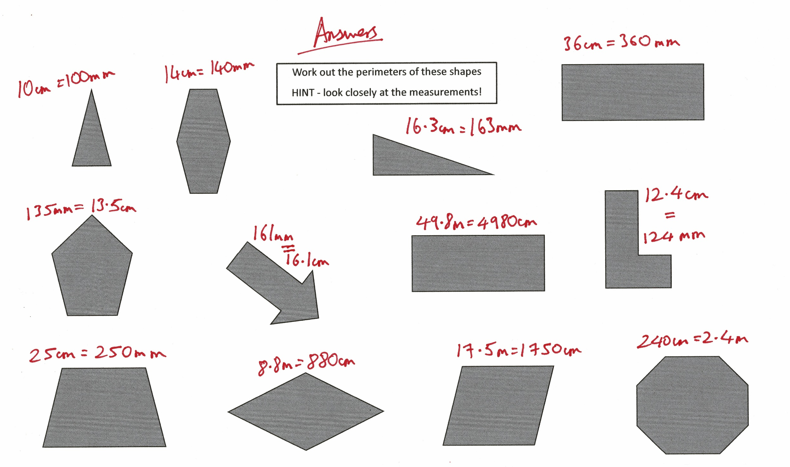

Slide 3
Edit in own measurements for children to solve
Work out the perimeters of these shapes
HINT - look closely at the measurements!

